Slide 1






AWS Solutions Architect—Associate Level
Amazon Route 53

Slide 2





What You’ll Learn
Uses of Route 53 service
Route 53 manages DNS
Concepts of Routing policies
AWS recommended best practices for
Route 53
Costs associated with Route 53

Slide 3




Amazon Route 53 Overview
Overview of Route 53 concepts
3

Slide 4

Amazon Route 53 Overview
Amazon’s definition of Route 53:
“It is a highly available and scalable cloud Domain Name Servers (DNS) web service.” It is designed to give developers and businesses an extremely reliable and cost effective way to route end users to Internet applications by translating names like www.example.com into the numeric IP addresses like 192.0.
Amazon
Route 53

Slide 5


Domain Name Servers (DNS)
DNS provides a directory of domain names and translates them to IP addresses. Humans access information online through domain names, like nytimes.com or espn.com. Web browsers interact through Internet Protocol (IP) addresses. DNS translates domain names to IP addresses so browsers can load Internet resources.
Domain Name
IP addresses
www.simplilearn.com
192.168.0.1

Slide 6


Route 53 Uses
You can use Route 53 to route user traffic to AWS resources like EC2 instances, ELB, or S3 buckets.
EC2 instances
Elastic Load
Balancer
S3 buckets

Slide 7
Features of Route 53
Easy to register your domain − We can purchase all level of domains like .com, .net, .org, etc. directly from Route 53.
Highly reliable − Route 53 is built using AWS infrastructure. Its distributed nature towards DNS servers help to ensure a consistent ability to route applications of end users.
Scalable − Route 53 is designed in such a way that it automatically handles large volume queries without the user’s interaction.
Can be used with other AWS Services − Route 53 also works with other AWS services. It can be used to map domain names to our Amazon EC2 instances, Amazon S3 buckets, Amazon and other AWS resources.

Slide 8
Features of Route 53
Easy to use − It is easy to sign-up, easy to configure DNS settings, and provides quick response to DNS queries.
Health Check: Route 53 monitors the health of the application. If an outage is detected, then it automatically redirects the users to a healthy resource.
Cost-Effective − Pay only for the domain service and the number of queries that the service answers for each domain.
Secure − By integrating Route 53 with AWS (IAM), there is complete control over every user within the AWS account, such as deciding which user can access which part of Route 53.

Slide 9
Domain Name Registration
Route 53 provides Domain Name Registration so you can manage your domain names, such as
www.simplilearn.com.

Slide 10


Route 53 Benefits
Following are the Route 53 benefits:
Highly Available and Reliable Built and distributed across AWS infrastructure
Integrated with AWS
Fully integrated with AWS, use Amazon Route 53 to map domain names to other AWS resources
1
3
Highly Scalable
Requires no intervention and will scale automatically to handle large query volumes
Cost-effective
Only pay for the features
2
4

Slide 11
Amazon Route 53 and DNS
Details about Route 53 and DNS
9

Slide 12

DNS
DNS is used to translate domain names into IP addresses.
www.simplilearn.com
192.168.0.1

Slide 13
Terminologies
1. Domain Name
Human-friendly name for an Internet resource
???
☺
192.168.0.1
simplilearn.com

Slide 14
Terminologies (contd.)
2. IP Address
IP address is a network addressable location.
Each IP address has to be unique within its network. In your AWS VPC, you can have IP addresses like 10.0.1.0, but for websites, the network is the Internet, so a unique IP address is required.
An IPv4 address (dotted-decimal notation)
172 . 16 . 254 . 1
10101100 .00010000 . 111111110 . 00000001
An IPv6 address (dotted-decimal notation)
2001:0DB8:AC10:FE01:0000:0000:0000:0000
2001:0DB8:AC10:FE01::
Zeroes can be omitted
10.0.1.0
One byte=Eight bits
00100000000000001:00000110110111000:1000110000010000:1111111000000001
Thirty-two bits (4 x 8), or 4 bytes
0000000000000000:0000000000000000:0000000000000000:0000000000000000

Slide 15
Terminologies (contd.)
3. Top-Level Domain
A Top-Level Domain is the portion of the domain name furthest to the right.
Simplilearn.com
charity.org
University.edu
com
org
edu

Slide 16
Terminologies (contd.)
4. Hosts
The domain owner can define individual hosts within a domain that refers to separate services or computers.
www.simplilearn.com
mail.charity.org
ftp.university.edu
www
mail
ftp

Slide 17
Terminologies (contd.)
5. Subdomains
Subdomains are the parts that are underneath the top-level domain.
simplilearn.com
charity.org
university.edu
simplilearn
charity
university

Slide 18
Terminologies (contd.)
6. Fully Qualified Domain Name (FQDN)
A Fully Qualified Domain Name, or FQDN, also called an absolute domain, is the complete domain name for a specific computer on the Internet.
mail.charity.org
FQDN

Slide 19

Terminologies (contd.)
7. Name Server (NS)
A Name Server is a computer or service that translates domain names into IP addresses.
www.simplilearn.com www.google.com www.bbc.co.uk
192.182.239.21
212.21.32.4

Slide 20
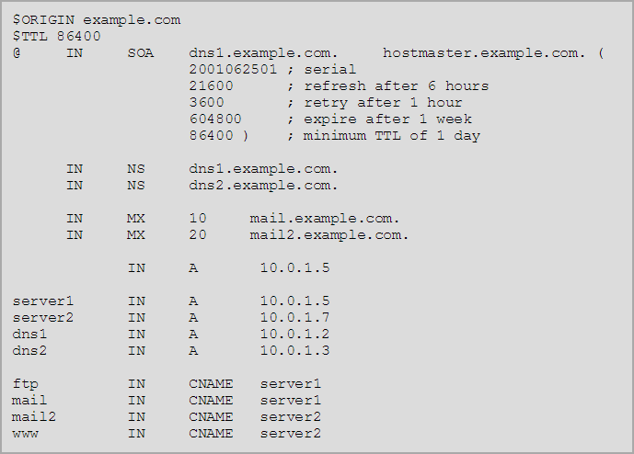
Terminologies (contd.)
8. Zone Files
Zone Files reside in name servers and are text files that contain the mappings between domain names and IP addresses.

Slide 21
Terminologies (contd.)
9. Start of Authority ( SOA)
A Start of Authority, or SOA, record is mandatory for every domain.
www.simplilearn.com
www.google.com
192.182.239.21
212.21.32.4

Slide 22
Terminologies (contd.)
10.Time-To-Live (TTL)
Time-to-Live, or TTL is the length of time (in seconds) that a DNS record is cached on a DNS server or on your PC before it rechecks the details.
www.simplilearn.com
192.168.0.1

Slide 23
Terminologies (contd.)
11.Records
A record maps a resource to a name.
www.simplilearn.com www.google.com
192.182.239.21
212.21.32.4

Slide 24
Records
There are four record types:
A Record
An “A Record” matches a domain (or subdomain) to an IP address.
CNAME
NS Record
Alias Record

Slide 25
Records (contd.)
There are four record types:
A Record
Canonical Name (CNAME) record matches a domain or subdomain to a different domain.
CNAME
NS Record
Alias Record

Slide 26

Records (contd.)
There are four record types:
A Record
A NameServer Record (NS Record) stores information about the name servers for a domain.
CNAME
NS Record
Alias Record

Slide 27



Records (contd.)
There are four record types:
A Record
An Alias Record is an AWS-created record and used only within AWS. It is similar to a CNAME, however, it’s used to map DNS names to ELB, S3 buckets, and CloudFront distributions within your hosted zone.
CNAME
NS Record
simplilearn.com
elb123456789.elb. amazonaws.com
Alias Record

Slide 28
Alias Record Summary
The following points present a summary of an Alias Record:
Automatically recognizes changes in the records sets that the Alias Record refers to
Always choose an Alias Record
over a CNAME
You aren’t charged to requests sent to an
Alias Record, but you are for a CNAME

Slide 29

Knowledge Check

Slide 30
KNOWLEDGE
CHECK
Why did AWS create an Alias Record?
a.
To create mappings to devices that have constantly changing IP addresses, like ELB, S3 buckets, and so on
Because CNAMES and A Records are becoming defunct
b.
c.
So you can create instances in different regions with the same name
d.
To increase the performance of an ELB

Slide 31


KNOWLEDGE
CHECK
Why did AWS create an Alias Record?
a.
To create mappings to devices that have constantly changing IP addresses, like ELB, S3 buckets, and so on
Because CNAMES and A Records are becoming defunct
b.
c.
So you can create instances in different regions with the same name
d.
To increase the performance of an ELB
The correct answer is a.
Alias Records were created to resolve the issue of CNAME naked domain mapping to A Record IP addresses. With some AWS services like ELB, the IP address is not always known.

Slide 32
Route 53 Routing Policies
Details of Amazon Route 53 Routing Policies
©Simplilearn. All rights reserved
30

Slide 33
Routing Policies
A routing policy determines how Amazon Route 53 responds to queries.
There are five available methods:
Simple
Weighted
Latency
Failover
Geolocation

Slide 34

Routing Policies (contd.)
Simple
Weighted
Latency
Failover
Geolocation
“Simple” is the default routing policy for a single resource.
www.simplilearn.com
192.168.0.1

Slide 35
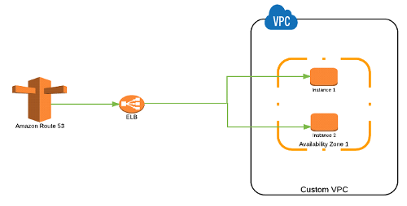
Simple Routing Policy
Amazon Route 53 — Simple Routing Policy is the most basic routing policy defined using an A record to resolve to a single resource always without any specific rules. For instance, a DNS record can be created to resolve the domain to an ALIAS record that routes the traffic to an ELB load balancing a set of EC2 instances.

Slide 36
Routing Policies (contd.)
Simple
Weighted
Latency
Failover
Geolocation
“Weighted” routing policy can split traffic based on different weights assigned.
30%
www.simplilearn.com
20%
50%

Slide 37
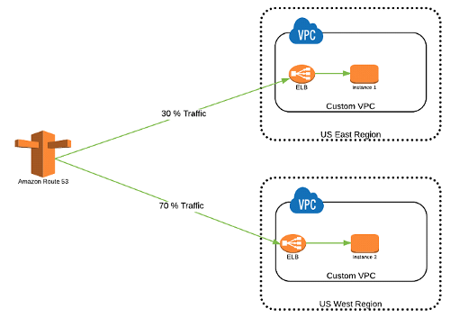
Weighted Routing Policy is used when there are multiple resources for the same functionality and the traffic needs to be split across the resources based on some predefined weights.

Slide 38

Routing Policies (contd.)
Simple
Weighted
Latency
Failover
Geolocation
“Latency” routing policy allows you to route traffic based on the lowest network latency for your end user.
13ms
US-EAST-1
81ms
US-WEST-1
US users
SA-EAST-1
114ms

Slide 39
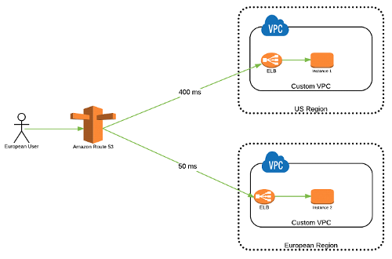
Latency Routing Policy is used when there are multiple resources for the same functionality and you want Route 53 to respond to DNS queries with answers that provide the best latency i.e. the region that will give the fastest response time.

Slide 40

Routing Policies (contd.)
Simple
Weighted
Latency
Failover
Geolocation
“Failover” routing policy allows you to have an active/passive setup.
PRIMARY
US users
STANDBY

Slide 41
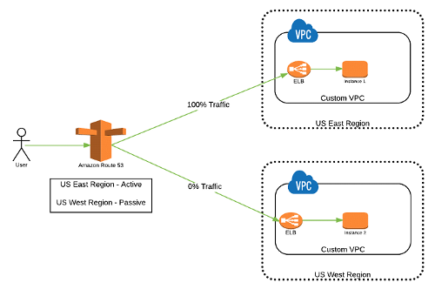
Failover Routing Policy is used to create Active/Passive set-up such that one of the site is active and serve all the traffic while the other Disaster Recover (DR) site remains on the standby. Route 53 monitors the health of the primary site using the health check.

Slide 42
Routing Policies (contd.)
Simple
Weighted
Latency
Failover
Geolocation
“Geolocation” routing policy routes traffic based on the geographic location of your users.
US-EAST-1
US users
EU-WEST-1
UK users

Slide 43
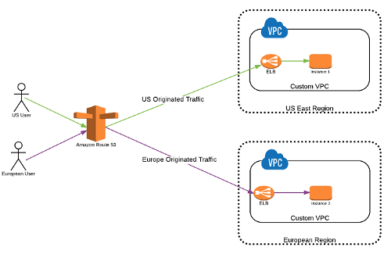
Geolocation Routing Policy is used to route the traffic based on the geographic location from where the DNS query is originated. This policy allows to send the traffic to resources in the same region from where the request was originated i.e. it allows to have site affinity based on the location of the users.

Slide 44


Demo 1: Route 53 Hosted Zones
Demonstrate how to configure Route 53 Hosted Zones.
©Simplilearn. All rights reserved
37

Slide 45
Knowledge Check

Slide 46
KNOWLEDGE
CHECK
Which of the following are Amazon Route 53 Routing Policies?
a.
Simple, Weighted, Network, Failover, and Geolocation
b.
Easy, Weighted, Latency, Migration, and Geolocation
c.
Easy, Defined, Latency, Failover, and Geodiverse
d.
Simple, Weighted, Latency, Failover, and Geolocation

Slide 47
KNOWLEDGE
CHECK
Which of the following are Amazon Route 53 Routing Policies?
a.
Simple, Weighted, Network, Failover, and Geolocation
b.
Easy, Weighted, Latency, Migration, and Geolocation
c.
Easy, Defined, Latency, Failover, and Geodiverse
d.
Simple, Weighted, Latency, Failover, and Geolocation
The correct answer is d.
Simple, Weighted, Latency, Failover, and Geolocation are Amazon Route 53 Routing Policies.

Slide 48
Amazon Route 53 Best Practices
Overview of AWS Best Practices for Route 53
©Simplilearn. All rights reserved
41

Slide 49
Route 53 Best Practices
Following are the Route 53 best practices:
Name Server Delegation
Route 53 hosted zones assign a delegation set of 4 name servers (.com, .net, .org, and .co.uk).
Update your registrar’s name server configuration with all of these name servers to provide maximum availability.
TTL Resource Record Sets
Alias Records vs. CNAME
Minimize Latency

Slide 50
Route 53 Best Practices (contd.)
Following are the Route 53 best practices:
Name Server Delegation
Resource records can benefit from a lower TTL value.
For long TTLs, DNS resolvers take longer to request updated DNS records.
TTL Resource Record Sets
Alias Records vs. CNAME
Minimize Latency

Slide 51
Route 53 Best Practices (contd.)
Following are the Route 53 best practices:
Name Server Delegation
When configuring resource record sets that route DNS queries to AWS resources, use Alias Record sets.
Alias Record sets are free of charge.
TTL Resource Record Sets
Alias Records vs. CNAME
Minimize Latency

Slide 52
Route 53 Best Practices (contd.)
Following are the Route 53 best practices:
Name Server Delegation
Use latency or Geolocation routing policies to provide users with the best response times.
Use health checks to ensure users are rerouted to healthy instances during an outage.
TTL Resource Record Sets
Alias Records vs. CNAME
Minimize Latency

Slide 53
Amazon Route 53 Costs
Details about costs associated with Amazon Route 53
46

Slide 54
Route 53 Costs Overview
The diagram presents an overview of the costs associated with Route 53:
Health Checks
Cost per month per
health check
04
DNS Queries
Charged per million queries, the cost varies depending on the type of routing policy used
Traffic Flow
Cost per traffic flow policy per month
02
03
Hosted Zones
Cost per hosted zone per month
01

Slide 55
Practice Assignment: Amazon Route 53 Hosted Zone
Configure Route 53 to manage your Domain Name using a Hosted Zone
©Simplilearn. All rights reserved
48

Slide 56

Configure Route 53 Hosted Zone
Your company wants to use Amazon Route 53 to manage its website. You will need to perform the following steps:
Set up an EC2 instance as the webserver.
Configure an ELB to manage traffic to the webserver.
Configure a Route 53 Hosted Zone to manage your Domain Name.
BONUS: You can refer to the demonstration of this lesson as a reference for this
Practice Assignment.

Slide 57
Key Takeaways
©Simplilearn. All rights reserved
50

Slide 58
Key Takeaways
Route 53 provides Domain Name System services that provide a domain name to IP address mapping.
Alias Record is similar to a CNAME, however, it’s used to map DNS names to ELB, S3 buckets, and CloudFront distributions within your hosted zone.
A routing policy determines how Amazon Route 53 responds to queries. There are five types of routing
policies: Simple, Weighted, Latency, Failover, and Geolocation.

Slide 59





This concludes “Amazon Route 53.”
The next lesson is “Databases.”
©Simplilearn. All rights reserved
52

